Slide 1
Building Real-Time Sales Dashboard
CPSC - 531 ADVANCED DATABASE MANAGEMENT SYSTEMS
PROF: TSENG-CHING JAMES SHEN, PhD
Team members:
Sandeep Divakaruni
Harshini Madhurai

Slide 2
CONTENTS
Introduction
Dataset Overview
Architecture
Tools and Technologies
Libraries used
Implementation Approach

Slide 3
INTRODUCTION
The agenda is to develop a Streaming application that ingests and processes
real-time sales data.
Utilized E-commerce data as our primary data source in this project due to its ease of readability and understandability compared with other data sources.
This project process large volumes of data efficiently using big data technologies.
Advantages of streaming Applications: Real-time insights, Continuous data flow, Suits modern data-driven applications.

Slide 4
WHAT WE ARE GOING TO ACHIEVE:
INVENTORY DETAILS
SALES DATA
E-Commerce
PAYMENT DETAILS
ORDER DETAILS

Slide 5

DATASET SOURCES
Originally, our plan involved sourcing data from APIs across various E-Commerce Portals. However, we encountered challenges in identifying a suitable API due to the disparate data formats utilized by various companies, as well as the limited accessibility of data from certain entities. To overcome these obstacles, we opted to simulate data generation internally, ensuring consistency and control over the data acquisition process.

Slide 6






ARCHITECTURE:
Data Source
Message Layer
Data Processing/Data Analytics
Data Storage
Visualisation/UI
Step No. 3
Step No. 4
Step No. 5
Step No. 1
Step No. 2
Building Data Processing Pipeline using Apache Spark(Python and Scala) and Apache Hadoop
Aggregated Data is stored in MySQL Database and HDFS(Distributed Storage)
Simulated Online Orders Data(Sales) to Kafka Topic
Building Real-Time Sales Dashboard using Python Django and Chart.js
Apache Kafka acts as
Message Broker
Data Ingestion
Data Processing
Chart.js

Slide 7
TOOLS AND TECHNOLOGIES USED:
• Big Data Technologies:
Kafka
Apache Spark
PySpark for real-time data processing
Persistent Storage:
MySQL
HDFS
• Languages and Libraries:
Python for scripting
PySpark for Spark application
Visualization :
Django
Chart.js
Other Tools:
WinSCP
Putty

Slide 8
Installing necessary libraries
1. kafka-python:
Purpose: Provides tools to produce and consume messages in Apache kafka using python.
Installation: pip install kafka-python
2. django:
Purpose: Creating interactive visualizations.
Installation: pip install django
3. channels:
Purpose: It supports protocols primarily web sockets and allows both synchronous and asynchronous programming.
Installation: pip install channels
4. channels-redis
Purpose: Django channels uses redis to distribute that message to all connected clients.
Installation: pip install channels-redis
5. mysqlclient:
Purpose: To connect MySQL server.
Installation: pip install mysqlclient

Slide 9
Additonal Dependencies
Java
Apache Spark requires Java to be installed on your system.
Make sure you have a compatible Java version installed.

Slide 10
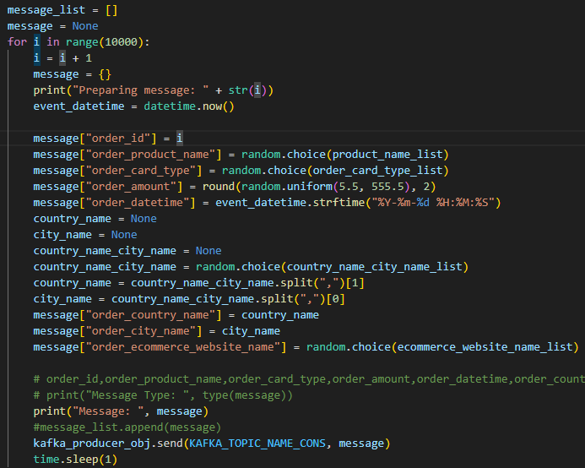
IMPLEMENTATION APPROACH
DATA SOURCE:
In this project, data is generated through simulation, comprising sales data such as product names, order IDs, order amounts, order dates, and payment details including card types and payment dates.

Slide 11
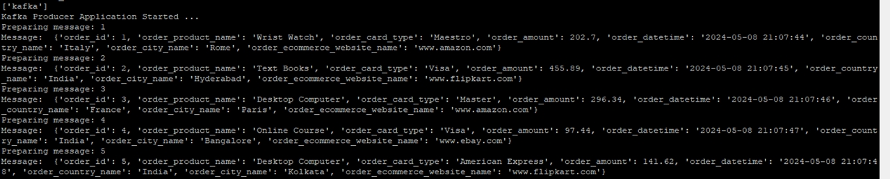
The console output appears as follows:

Slide 12
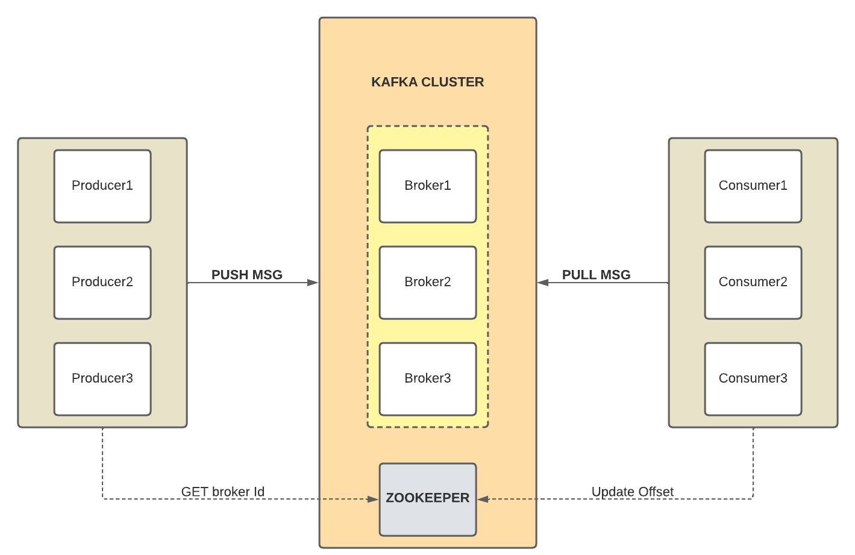
IMPLEMENTATION APPROACH
MESSAGE LAYER
We opted for Apache Kafka as our messaging layer due to its distributed nature, which effectively mitigates failures and serves as a buffer with minimal latency.
It follows Publish and Subscribe mechanism.

Slide 13
IMPLEMENTATION APPROACH
DATA PROCESSING/DATA ANALYTICS
Generally, there are two distinct types of analysis: batch/offline analysis and online/real-time analysis.
In this project, we have prioritized the implementation of real-time analysis for sales data over traditional batch/offline analysis.
During this phase, we undertake two primary tasks: data ingestion and data processing.
Apache Spark is designed to handle both batch processing and stream processing, along with facilitating various machine learning implementations.
In our project, we leveraged Spark Structured Streaming.
This enabled us to capture streaming data and conduct real-time data processing, ultimately storing aggregated data in a chosen persistent data storage.

Slide 14
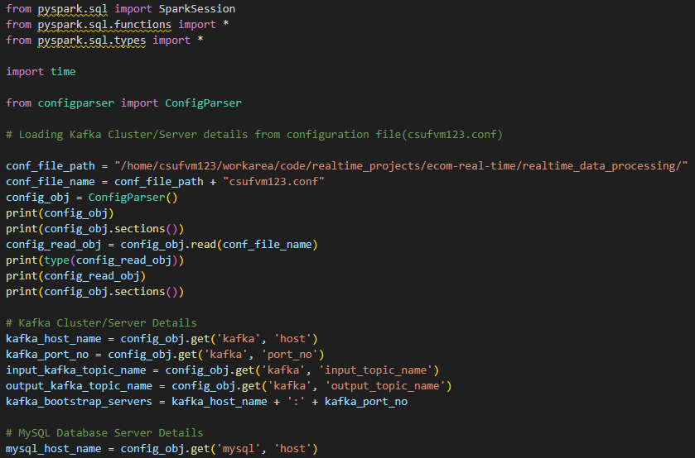

Slide 15
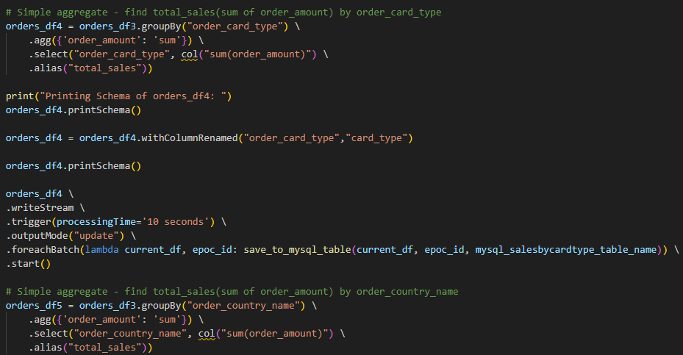

Slide 16
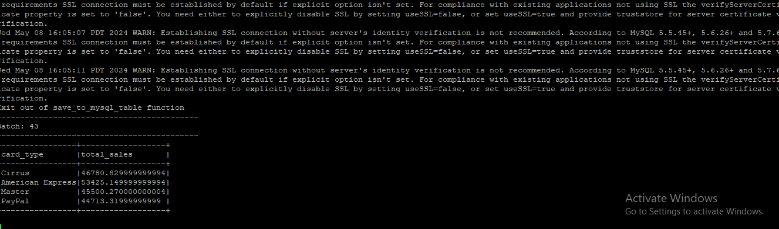
The console output appears as follows:
AGGREGATED / METRICS DATA

Slide 17
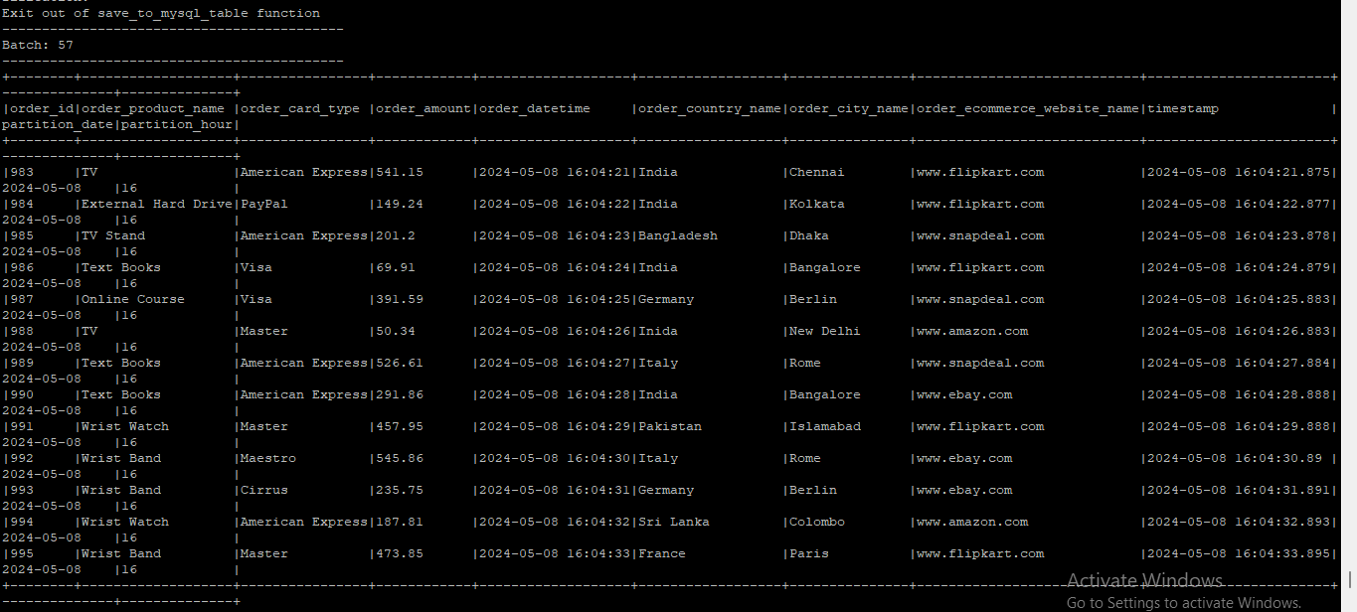
Raw Data to be Stored in HDFS

Slide 18
IMPLEMENTATION APPROACH
DATA STORAGE
We utilized MySQL for storing aggregated data and HDFS for storing raw data.
The aggregated data stored in MySQL is leveraged within the visualization layer for reporting and analysis purposes.
On the other hand, the raw data residing in HDFS serves as a foundation for future analytics endeavors, employing machine learning algorithms for advanced insights and predictive modeling.

Slide 19
IMPLEMENTATION APPROACH
VISUALIZATION
In this layer, we've implemented a real-time sales dashboard utilizing the following technologies:
Chart.js : Leveraging this JavaScript library for dynamic and interactive data visualization.
Django : Django, serves as the backbone for this dashboard,
facilitating robust backend functionality and streamlined data management.

Slide 20
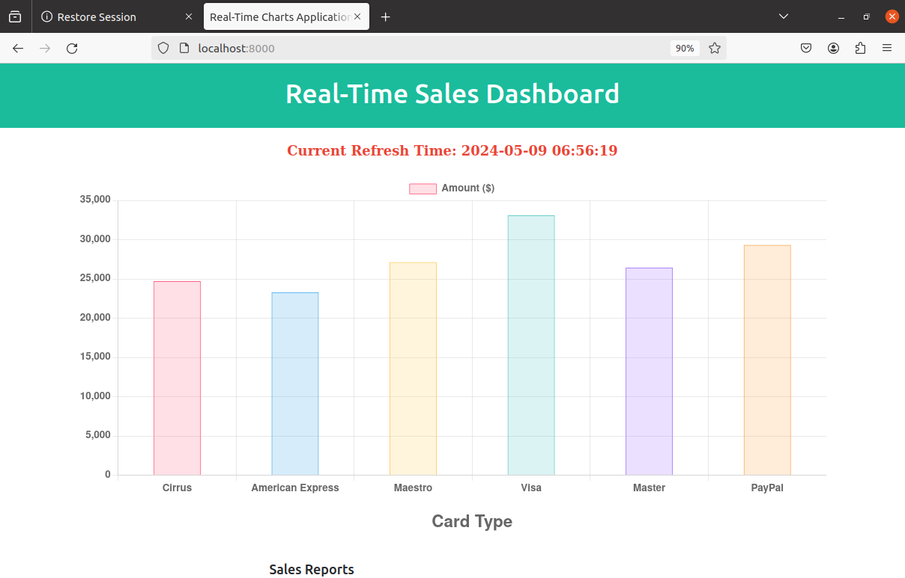
A live-updating graph displaying the real-time sales data.

Slide 21
THANK YOU

